Slide 1
Driver Drowsiness Alarm System
Muhammad Umair BSEF18M005
Muhammad Sami Ullah BSEF18M040
Muhammad Asim Raza BSEF18M042
Project Manager Dr. Humaira Bilal

Slide 2
Abstract
The main purpose of this system is to develop a drowsiness detection system by monitoring the eyes.
It is believed that the symptoms of driver fatigue can be detected early enough to avoid a car accident. Driver drowsiness pose a major threat to highway safety.
In this system we will first detect the face of person and then we will monitor the eyes of the driver through algorithm.

Slide 3
Scope
It can be used in any environment that requires to monitor someone’s activeness.
Automobiles
industrial employees
security officers
train operator
commercial aero plain pilots

Slide 4
Objectives
Driver drowsiness detection is a car safety technology will help to save the life of the driver by preventing accidents when the driver is getting drowsy.
The main objective is to first design a system to detect driver’s drowsiness by continuously monitoring retina of the eye.
To alert the driver on the detection of drowsiness by using buzzer or alarm.
Traffic safety can be increased by reducing the accidents.

Slide 5
Components Used
Raspberry Pi
Camera
Buzzer/ Speaker

Slide 6
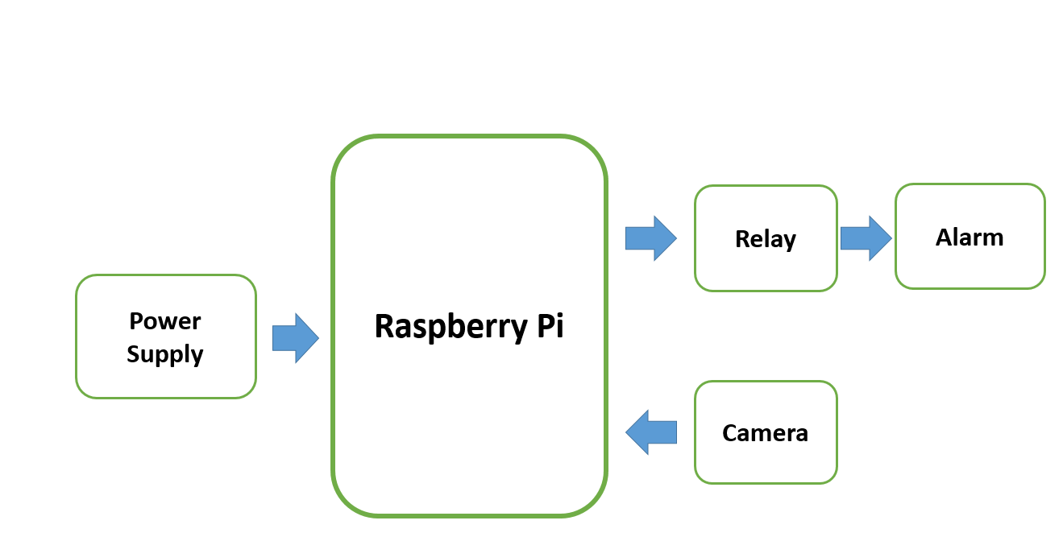
Working

Slide 7
Data Flow In System

Slide 8
Functional Requirements
Video Capturing
Face Recognition
Eyes Detection
Drowsiness Detection
Running Alarm System

Slide 9
Non-functional Requirement
Security Requirement
Portability Requirement
Maintainability Requirement

Slide 10
Tools Used
Python 3
OpenCV
Dlib

Slide 11
Raspberry Pi
The Raspberry Pi is a low cost, credit-card sized computer that plugs into a computer monitor or TV, and uses a standard keyboard and mouse.
It is a capable little device that enables people of all ages to explore computing, and to learn how to program in languages like Scratch and Python.
Raspberry Pi has the ability to interact with the outside world

Slide 12
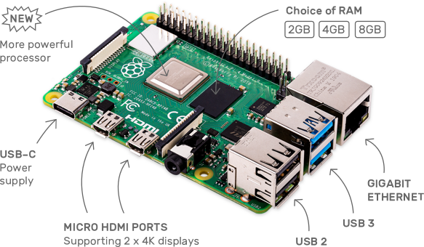
Raspberry Pi

Slide 13
Open CV
Open CV is a huge open-source library for computer vision, machine learning, and image processing.
It can process images and videos to identify objects, faces, or even the handwriting of a human.

Slide 14
Dlib
DLib is an open source C++ library implementing a variety of machine learning algorithms
It's a landmark's facial detector with pre-trained models, the dlib is used to estimate the location of coordinates (x, y) that map the facial points on a person's face

Slide 15
The End

